Slide 1
What factors affect climate?
Lesson 3.6

Slide 2
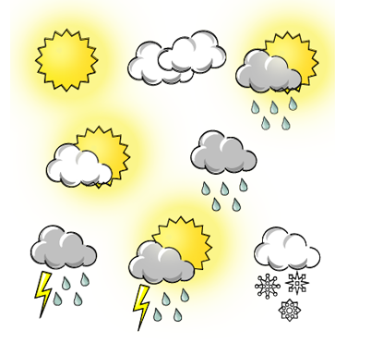
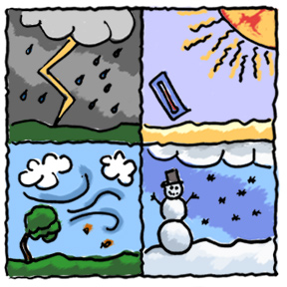
Climate is the long-term weather patterns of a given place.
Weather is the day-to-day changes in the atmosphere that over the long term is climate.

Slide 3
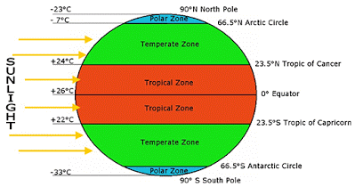
Climate zones are areas that have similar average temperatures and precipitation.
The three climate zones are temperate, tropical, and polar.

Slide 4
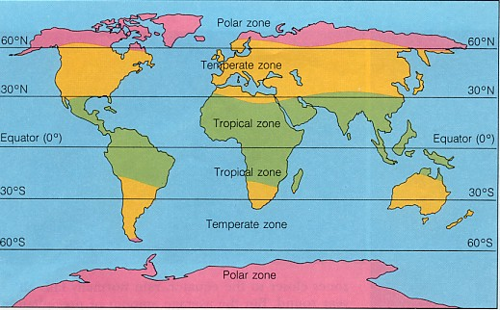
Tropical climates are warm and occur mostly around the equator (the equator is the imaginary line that divides the Earth into Northern and Southern Hemispheres).

Slide 5
Temperate climates are found at the middle latitudes between tropical and polar zones. Temperatures here can vary depending on how far or close they are to another zone.

Slide 6
Polar climates are farthest from the equator. They are always cold and have little precipitation.

